Slide 1
Large Displacement Optical Flow:
Descriptor Matching in Variational Motion Estimation
Thormas Brox, Jitendra Malik
IEEE TRANSACTIONS ON PATTERN ANALYSIS AND MACHINE INTELLIGENCE 2010
Presenter：Haw-Shiuan Chang

Slide 2
Outline
Introduction
  Problem
  Application
  Challenge
Motivation
  Traditional method
  Encounter problem
Method
  Descriptor match
  Combine descriptor match and continuous method
  Optimization
Experiments
Conclusion
  Advantage/disadvantage

Slide 3
Outline
Introduction
  Problem
  Application
  Challenge
Motivation
  Traditional method
  Encounter problem
Method
  Descriptor match
  Combine descriptor match and continuous method
  Optimization
Experiments
Conclusion
  Advantage/disadvantage

Slide 4
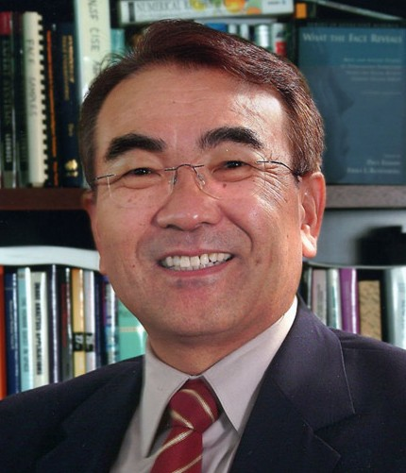
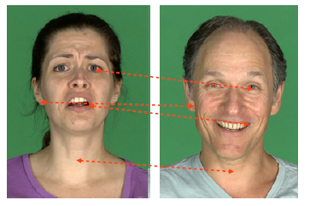
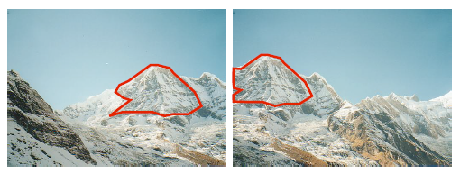
The three most important problems in computer vision are:
1. Registration
2. Registration
By Takeo Kanade,
Carnegie Mellon University.
3. Registration
This slide comes from Artificial Intelligence course (15381) at CMU in Fall 2010

Slide 5
Registration type
Images
  Scene to scene
  Object to object
    Classification /clustering /detection methods
  Space to space
    Geometry-based methods
  Point to point
    Descriptor-based methods
Video
  Region to region
    tracking methods
  Point to point
    Optical flow /stereo matching

Slide 6
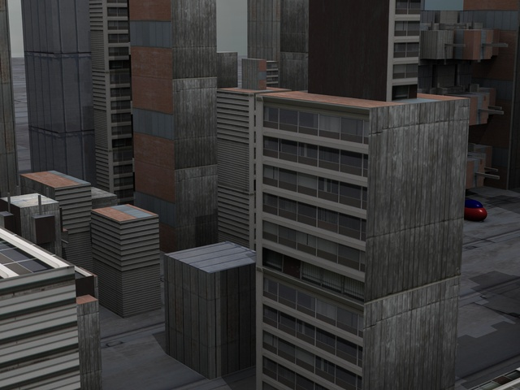

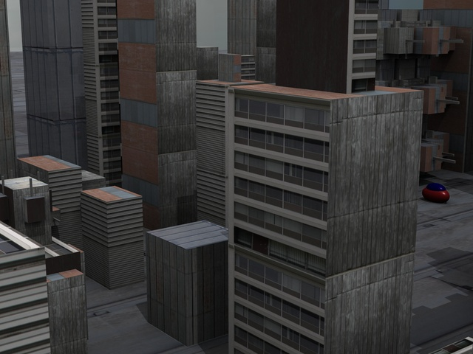
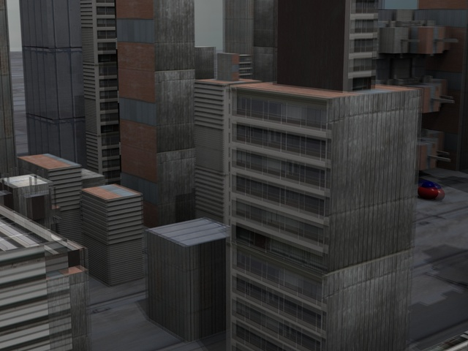
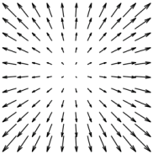

Optical flow problem
Middlebury Benchmark [Baker et al. 07]
Dominant Scheme: Coarse-to-Fine Warping
This example comes from Motion Detail Preserving Optical Flow Estimation CVPR talk

Slide 7
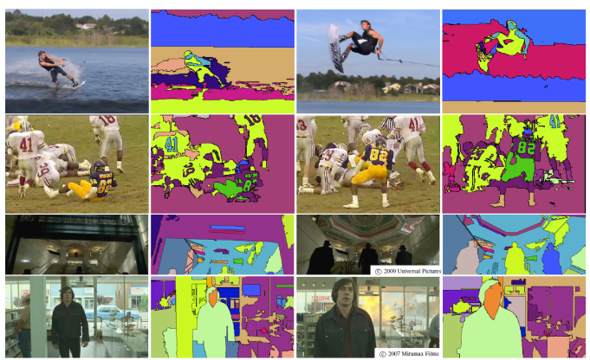
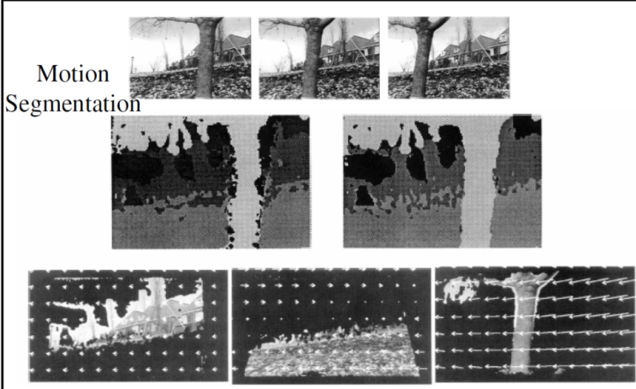
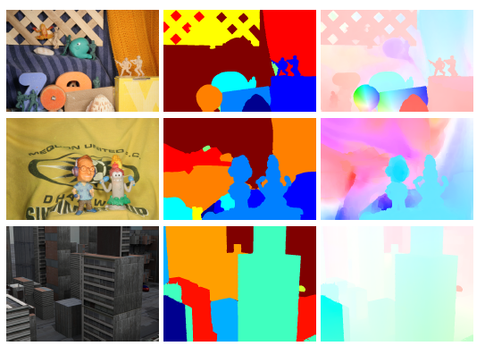
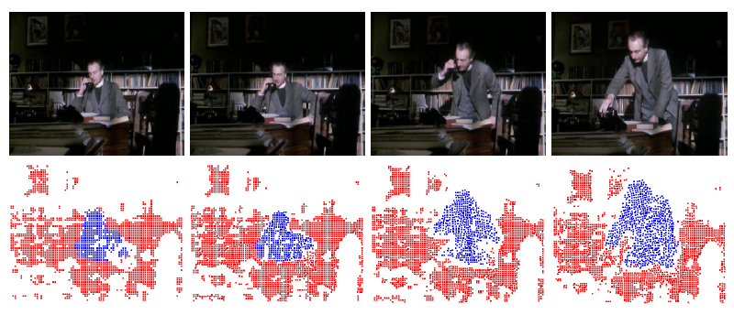
Application - Segmentation
Motion segmentation
Video segmentation
Efficient Hierarchical Graph-Based Video Segmentation, CVPR 2010
Layered Representation of Motion Video using Robust Maximum-Likelihood Estimation of Mixture Models and MDL Encoding, ICCV 1995
Object Segmentation by Long Term Analysis of Point Trajectories, ECCV 2010
Layered Segmentation and Optical Flow Estimation Over Time, CVPR 2012

Slide 8
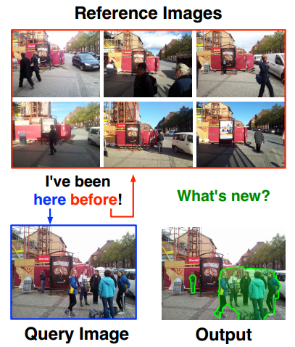
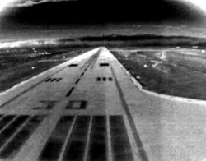
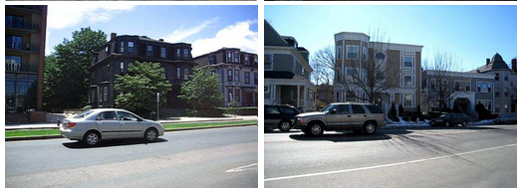
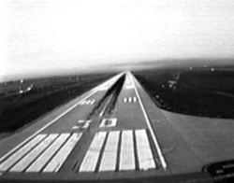

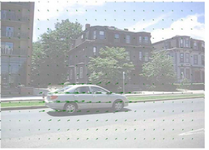
Application - Retrieval
Motion synthesis via moving objects transfer
Novelty/background separation
Auto morphing
SIFT Flow: Dense Correspondence across Scenes and its Applications
PAMI 2011
Multi View Registration for Novelty/Background Separation CVPR 2012

Slide 9
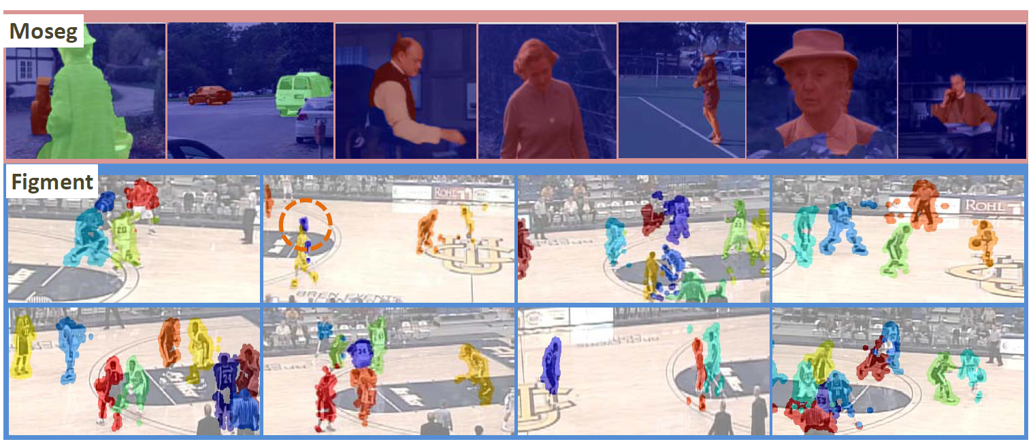
Application –
Detection-Free Multiple Object Tracking
Optical Flow -> point trajectory -> motion cue
Motion cue + saliency cue + spatial cue = tracking
Video Segmentation by Tracing Discontinuities in a Trajectory Embedding CVPR 2012

Slide 10
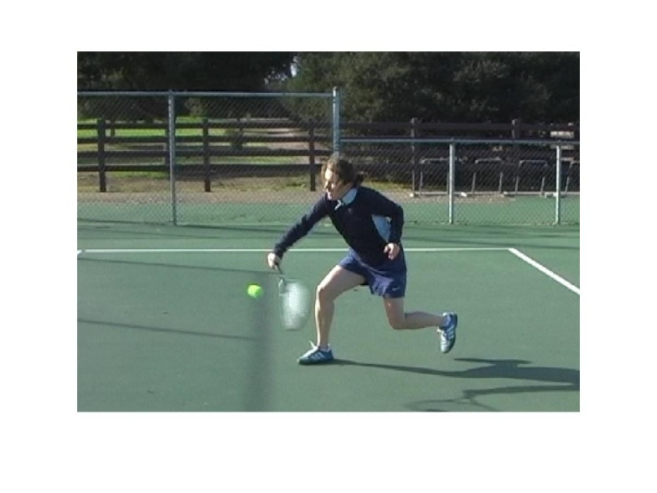
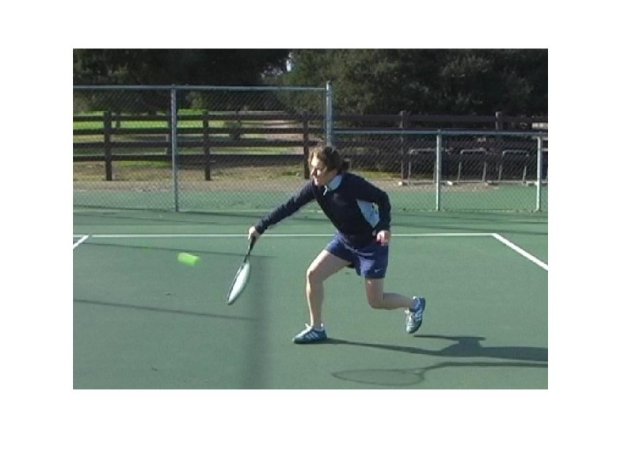
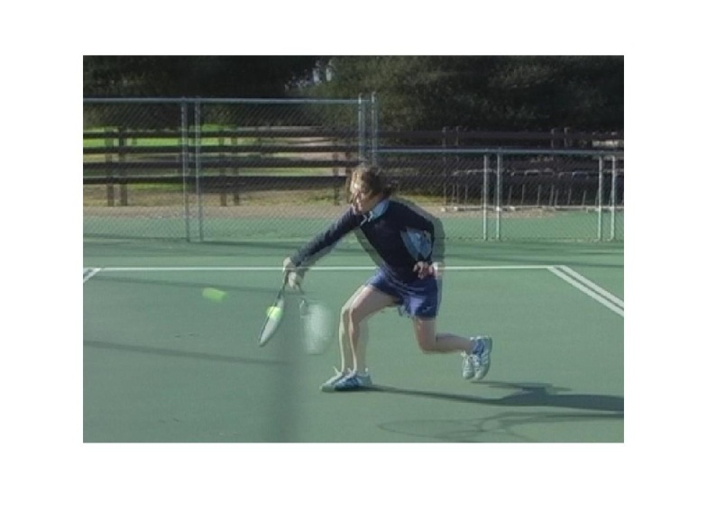
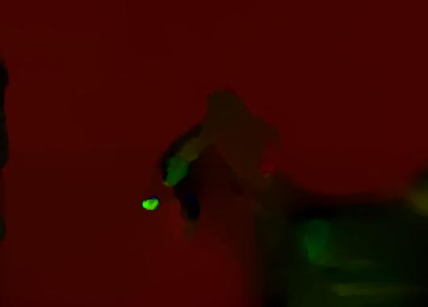
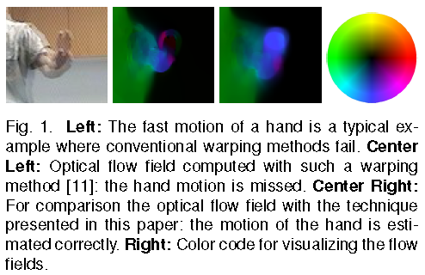
Challenge - Optimization
Dense match
  High dimension optimization problem
Local ambiguity / aperture problem
  Highly non-convex minimization
Large displacement
  Large search space
  Non-linear optimization problem
This example comes from Freiburg-Berkeley Motion Segmentation Dataset (FBMS-59)

Slide 11

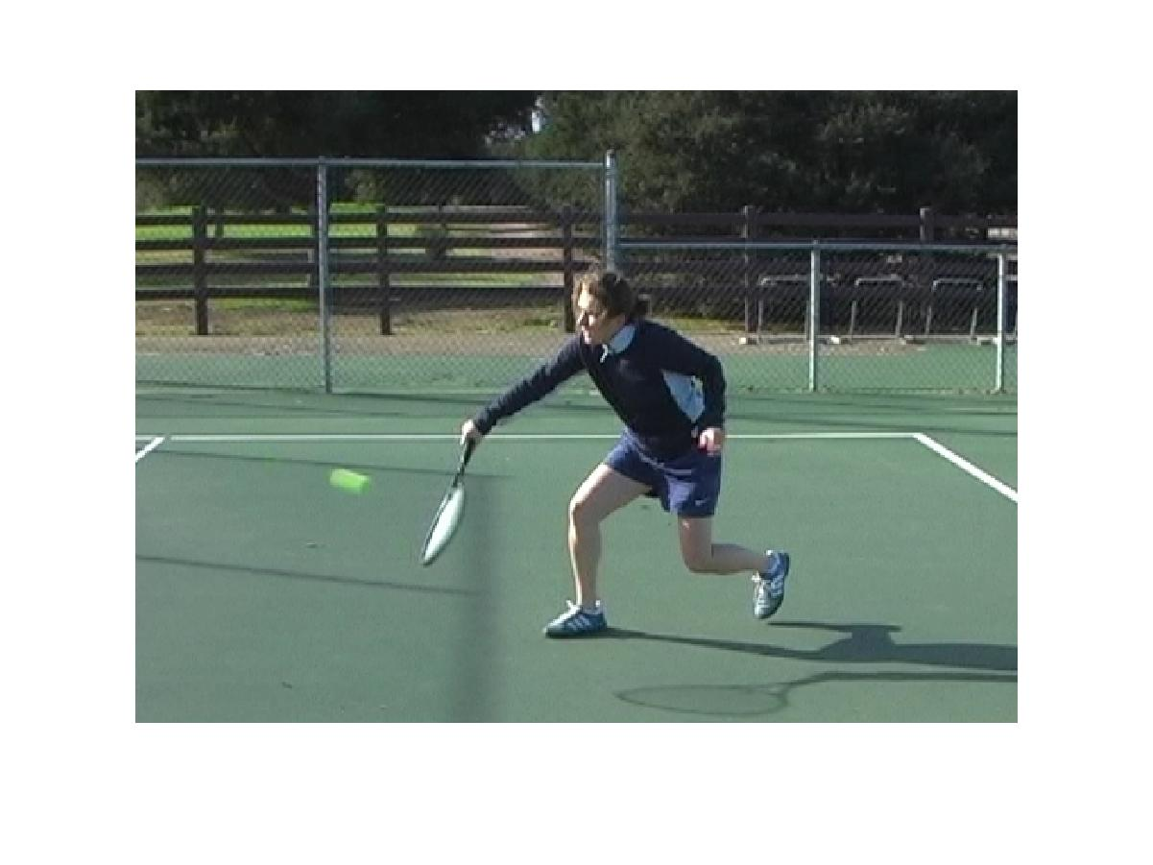

Challenge – Changing features
Non-rigid motion
Scale change
Occlusion
Illumination change
Motion blur
Noise
…
Unlike tracking, the state-of-the-art optical flow methods still couldn’t deal with too complex cases.
However, it improves a lot recently.

Slide 12
Optical flow development track
1989
Determining Optical Flow
The Robust Estimation of Multiple Motions: Parametric and Piecewise-Smooth Flow Fields (Discontinuity)
A PDE Model for Computing the Optical Flow (Continuous domain)
Segmentation-Based Motion with Occlusions Using Graph-Cut Optimization
Illumination-Robust Variational Optical Flow with Photometric Invariants
Efficient MRF Deformation Model for Non-Rigid Image Matching
Fusionflow: Discrete-Continuous Optimization for Optical Flow Estimation
SIFT Flow: Dense Correspondence across Difference Scenes (across images)
Optical Flow Estimation on Coarse-to-Fine Region-Trees using Discrete Optimization
Large Displacement Optical Flow
Large Displacement Optical Flow Computation without Warping
Motion Detail Preserving Optical Flow Estimation (Large/small Displacement)
1996
1999
2006
2007
2008
2009
2010

Slide 13
Outline
Introduction
  Problem
  Application
  Challenge
Motivation
  Traditional method
  Encounter problem
Method
  Descriptor match
  Combine descriptor match and continuous method
  Optimization
Experiments
Conclusion
  Advantage/disadvantage

Slide 14
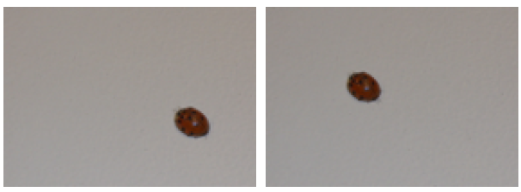
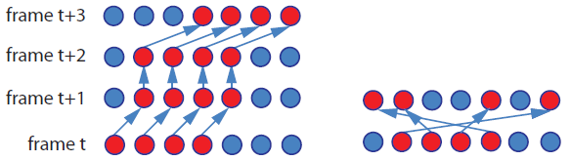

Traditional optical flow objective function
Define
  W(x,y,t)=( u(x,y,t) , v(x,y,t) ,1)
  X(x,y,t)=( x,y,t )
E(W)=E_{D}(W)+αE_{S}(W)
y
v(2,1)
1
pixel
u(2,1)
x
2
I(x+u,y+v,t)
I(x+u,y+v,t+1)
I(x,y,t)
$$=\sum_{{\text{x}}_{0},{\text{y}}_{0}}{{\left(\left.\text{I}({\text{x}}_{0}{\text{+}\text{u}\text{(}\text{x}}_{0}{\text{,}\text{y}}_{0}{\text{,}\text{t}}_{0}\text{)},{\text{y}\text{+}\text{v}\text{(}\text{x}}_{0}{\text{,}\text{y}}_{0}{\text{,}\text{t}}_{0}\text{)},{\text{t}}_{0}\text{+1})−\text{I}({\text{x}}_{0},{\text{y}}_{0},{\text{t}}_{0}\right)\right)}^{2}+}\text{α}\sum_{{\text{x}}_{0},{\text{y}}_{0}}{\frac{1}{8}}\sum_{j∈N_{(x_{0},y_{0},t_{0})}}{{(u\left({\text{x}}_{0},{\text{y}}_{0},{\text{t}}_{0}\right)−u_{j})}^{2}+{(v\left({\text{x}}_{0},{\text{y}}_{0},{\text{t}}_{0}\right)−v_{j})}^{2}}$$
This figure comes from “Motion coherent tracking with multi-label MRF optimization”, BMVC 2010

Slide 15
Data term linearization
In order to make objective function become convex, we can linearize the data term.
However, this approximation only hold when u and v are small.
How about when u and v are large?

Slide 16

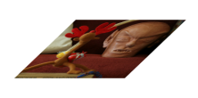
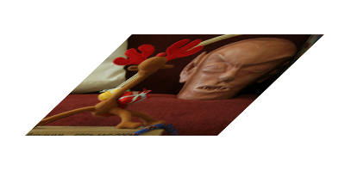
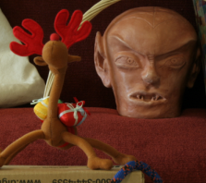
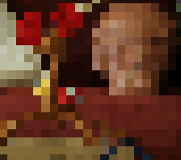
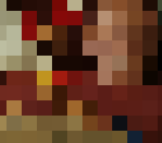
Coarse-to fine strategy

Slide 17
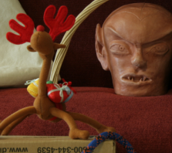
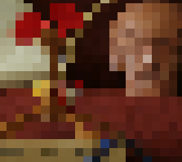
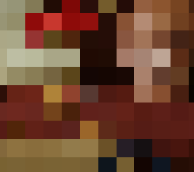
The Multi-scale problem
Ground truth
Ground truth
Ground truth
Notes:
The ground truth flow for these highlighted pixels are shown with the arrows.

Slide 18
The Multi-scale problem
Ground truth
Ground truth
Ground truth

Slide 19



Ground truth
Ground truth
Ground truth
Estimate
Estimate
Estimate
…
This example comes from Motion Detail Preserving Optical Flow Estimation CVPR talk

Slide 20
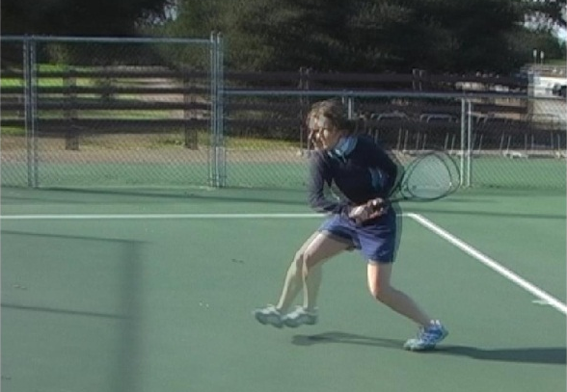
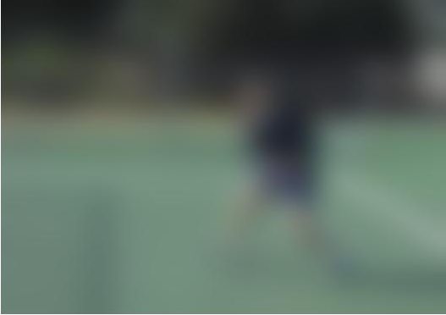
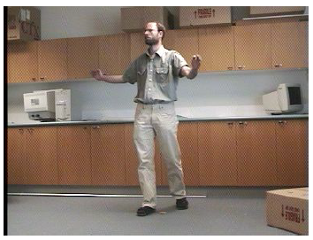
Motivation
Unfortunately, objects moving fast are often small in this word, and when
  Local motion >
  own structure
  The moving part disappears due to the coarse-to-fine matching.
Overlap input
coarse-to-fine
LDOF

Slide 21
Outline
Introduction
  Problem
  Application
  Challenge
Motivation
  Traditional method
  Encounter problem
Method
  Descriptor match
  Combine descriptor match and continuous method
  Optimization
Experiments
Conclusion
  Advantage/disadvantage

Slide 22
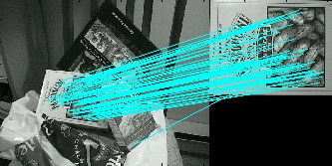

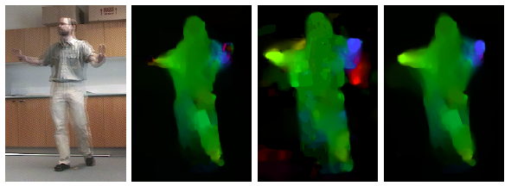
Descriptor match
Globally optimize:
Type
  SIFT?
  Region?
  HOG(histogram of oriented gradients) or GB(geometric blur)?
Pros:
  No distance constraint
Cons:
  Outlier from complex scene or occlusion
  Sparse discrete match
  Limited for changing features
Baseline
HOG
Can we combine the (sparse) descriptor match with the (dense) coarse-to-fine strategy?

Slide 23





Objective function
Conventional: E(W)=E_{D}(W)+ α E_{S}(W)
LDOF: E(W)=E_{color}(W)+γE_{gradient}(W)+αE_{smooth}(W)
+βE_{match}(W,W₁)+E_{desc}(W₁)
E_{D}(W)
E_{s}(W)
Loss to decide W₁(x)
W₁(x): descriptor match result
Descriptor match constraint
Loss to make W close to W₁
robust penalty function
(s ↓ quadratic, s ↑ linear )
δ(x): indicate match function
ρ(x): confidence of descriptor match
f(x): the feature space of descriptor

Slide 24
Optimization process
Descriptor match to globally optimize W₁
Graduated non-convex optimization
  One hard problem (non-convex, non-linear)
  Many easier sub-problems(convex, linear)
Coarse-to-fine + Linearization
Discretize
Why still could be “linearize”?
Why still using “coarse-to-fine”?
Why continuous model?

Slide 25
Outline
Introduction
  Problem
  Application
  Challenge
Motivation
  Traditional method
  Encounter problem
Method
  Descriptor match
  Combine descriptor match and continuous method
  Optimization
Experiments
Conclusion
  Advantage/disadvantage

Slide 26
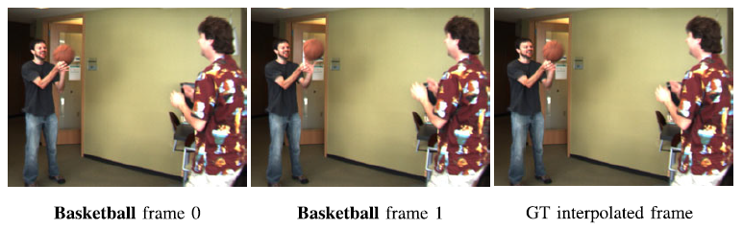
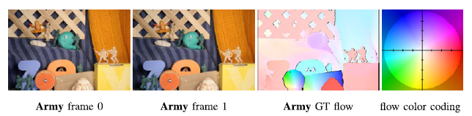
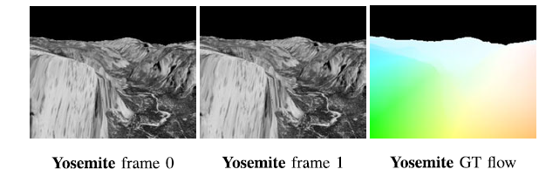
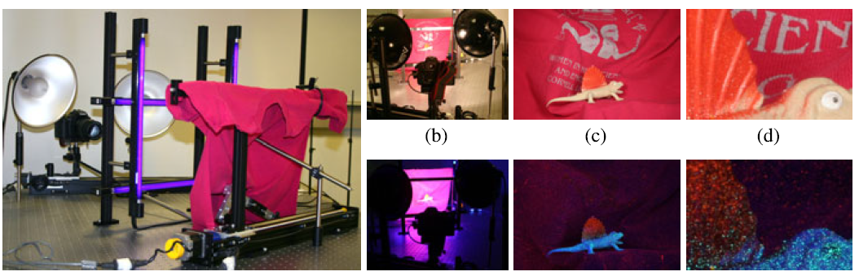
Middlebury benchmark (IJCV2011)
In optical flow problem, ground truth is hard to get.
This benchmark uses
  High speed camera
  Fluorescent
  Synthetic scene

Slide 27
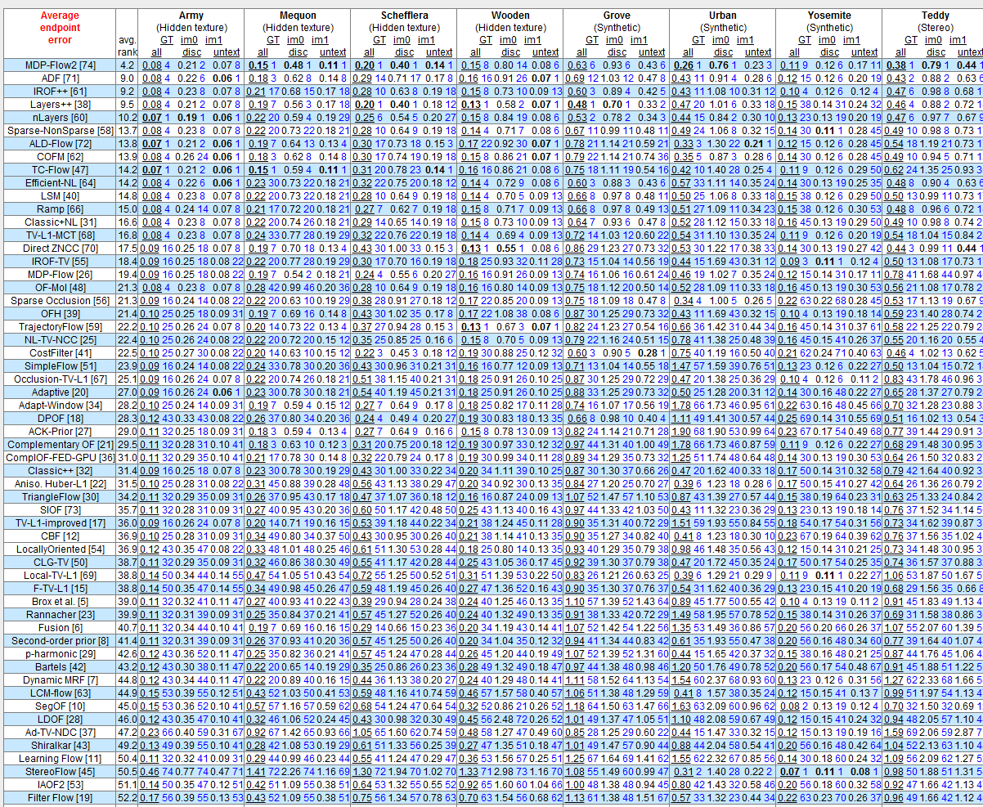
Price of large displacement
There is
“No” large displacement in Middlebury dataset.
Average endpoint error
Conventional baseline(2004)
0.501
LDOF(2009)
0.561

Slide 28
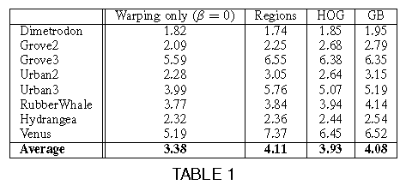
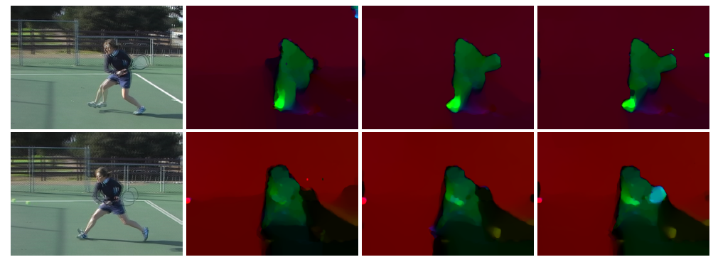
Comparison between chosen descriptor
No large displacement
ˇ
Region match is too sparse.
GB has more correct and wrong match.
HOG is more efficient.
Large displacement occurs
ˇ
Region
HOG
GB

Slide 29
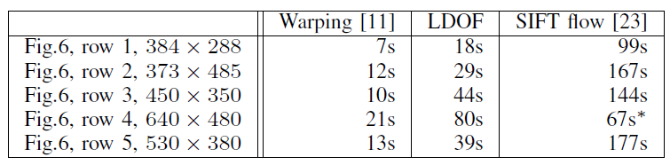
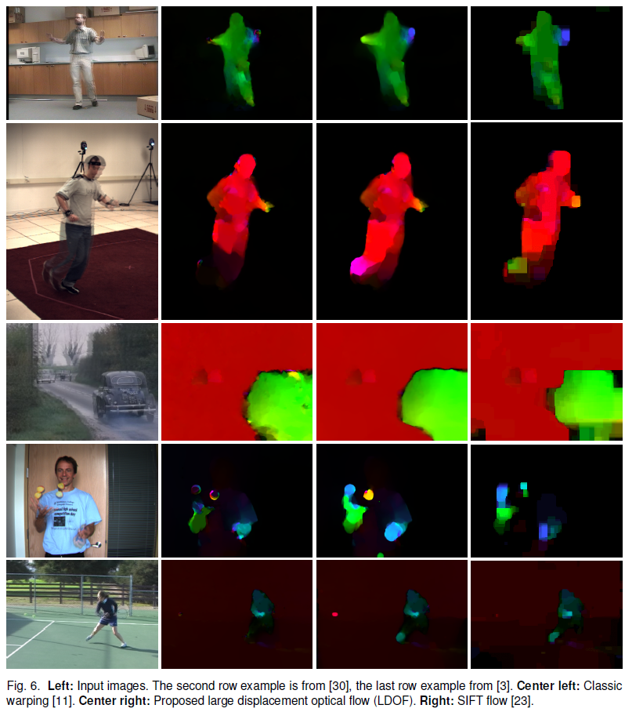
Comparison with only use descriptor match
LDOF is more accurate and can deal with occlusion and ambiguity in smoothly textural areas.
Baseline
HOG
LDOF
Baseline
LDOF
SIFT flow

Slide 30
Experiments on video with large displacement-1
http://lmb.informatik.uni-freiburg.de/research/opticalflow/

Slide 31
Experiments on video with large displacement-2
http://lmb.informatik.uni-freiburg.de/research/opticalflow/

Slide 32
Outline
Introduction
  Problem
  Application
  Challenge
Motivation
  Traditional method
  Encounter problem
Method
  Descriptor match
  Combine descriptor match and continuous method
  Optimization
Experiments
Conclusion
  Advantage/disadvantage

Slide 33
Conclusion
Investigates how to combine
    Descriptor match
    Classic coarse-to-fine method to optimize continuous energy function.
    (Variantional model)
LDOF becomes the first successful algorithm which deals with small scale objects with large movements.

Slide 34
Reference
Thomas Brox, Andres Bruhn, Nils Papenberg, Joachim Weickert, High Accuracy Optical Flow Estimation Based on a Theory for Warping ECCV 2004
Large Displacement Optical Flow CVPR 2009
Narayanan Sundaram, Thomas Brox, and Kurt Keutzer, Dense Point Trajectories by GPU-accelerated Large Displacement Optical Flow ECCV 2010
Thomas Brox, Jitendra Malik,Large Displacement Optical Flow: Descriptor Matching in Variational Motion Estimation PAMI 2010
Li Xu, Jiaya Jia, Yasuyuki Matsushita, Motion Detail Preserving Optical Flow Estimation PAMI 2012

Slide 35
Appendix

Slide 36
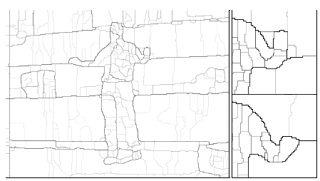
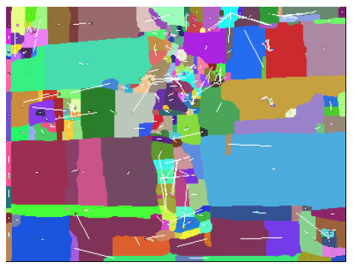
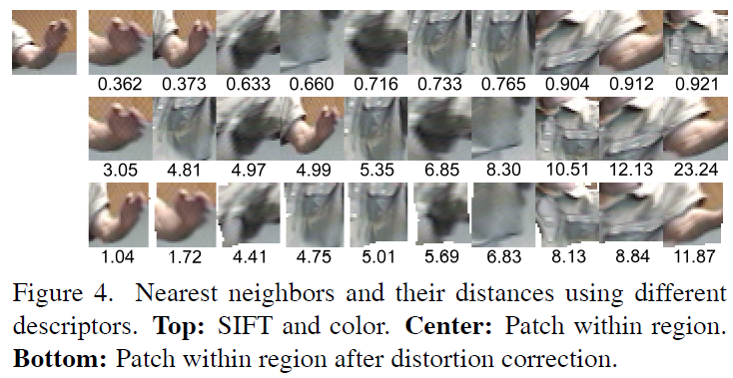


Descriptor match-
Region match
Segmentation method: gPb-owt-ucm
Normalize to 32x32 patch
Find 10 nearest patch
  SIFT + corresponding color feature
  Filter out:
    Too large displacement
    Too large scale change
Perform local deformation by conventional optical flow and select 5 nearest patch (or only best match)
Backward check

Slide 37


Descriptor match-
HOG & GB
efficient when using integral images
HOG
  15 bins, 7x7 neighborhood
  135 dimension for each point
  match from 1/16 points to all points
  Filter out points with no structure (smaller λ<1/8λ_{avg} of ▽I ▽I^{T})
  Backward check
GB
  15 bins, gaussian neighborhood with σ=0,1,2
  195 dimension for each point
This figure comes from Computer Vision course (16720) at CMU in Fall 2010

Slide 38






Domain and range
v(i)$∈$I
Vector
  Discrete to Discrete optimize problem
    MRF, CRF, Belief propagation, dynamic programming, Greedy search
  Discrete to Continuous optimize problem
    Closed-form solution
    EM algorithm
    Gradient descent
    …
Function
  Continuous to Continuous optimize problem
    Euler-Lagrange equation
In optical flow case,
different types of variable: different advantage
  The vector one: sharp edge
  The function one: subpixel accuracy
i$∈$I
v(i)$∈R$
i$∈$I
f(x)$∈R$
Subpixel accuracy
x$∈R$

Slide 39



Variational model
pixel
Calculus of variation(變分學)
  Finding a function which maximizes or minimizes a functional (objective function)
    solving a partial difference equation VS
    find maximum of functional
    ↨
    solving the equation VS
    maximize a function
  For example, finding the function of a line with smallest length on one surface.
Optical flow case
  Find the function from continuous Image coordinate domain to continuous shift range which fit two frames best
Flow array
x direction flow
y direction flow
Flow field

Slide 40
Why still could be “Linearize”?
Assume k=layer number
k=1
k=k₀
k=k₀+1
k=k₀+1
k=k₀
Fine pyramid scale (0.95 in this paper)
  du^{k}, dv^{k} small enough.
Linearize on du,dv instead of u, v:

Slide 41
Why still using “coarse-to-fine”?
  For large structure, the coarse-to-fine technique is more accurate than descriptor match.
For small structure:
Ideal dW^{k}
idealW^{k+1}
W^{k}
move distance > size scale
Ideal dW^{k} is too large to be found
Correct descriptor match
Ideal dW^{k}
idealW^{k+1}
W^{k}
Without descriptor match
W^{k}
Ideal
W^{k+1}
descriptor match W₁
Ideal dW^{k} become much smaller
With
descriptor match
W^{k}

Slide 42

coarse-to-fine example with large displacement
In coarse layer, the detail has been smoothed away.
So it shows the result of descriptor matches on the feet, racket and some outlier on background.

Slide 43

Why continuous model?
We have to discretize in the end, why don’t we discretize it at the first place?
traditional discrete objective function:
$E\left(W\right)=\sum_{x,y}{E\left(u(x,y,t_{0}),v(x,y,t_{0})\right)}$
continuous objective function
(variational model):
$$E\left(W\right)=\iint{E\left(u(x,y,t_{0}),v(x,y,t_{0})\right)dx,dy}$$
In the coarse-to-fine optimization process,
  Discrete objective function can’t see the subpixel accuracy difference until the finer level.
  The decision of coarse level will significantly affect the fine level.
Lost=0.29
Lost=0.28
Lost=0.3
Lost are different
But the discrete objective function can’t see the difference
vs
Lost=0.29

Slide 44




Optimize process
Euler-Lagrange equation:

Slide 45



It is like to warp image2 according to the W^{k} at every scale, and compute flow between wrapped image2 and image1
E^{k} is convex and can be globally optimize.
  By making many assumptions and approximations at the coarse-to-fine step.
  follow the spirit of graduated non-convex optimization.
If we don’t use continuous model
  How to discretize the equation at each scale without introducing any inconsistent discretizaion artifact?
  the relationships between flows on each scale are undefined…

Slide 46

Advantage
Relatively simple, robust and fast
  Provide source code of optical flow and GPU accelerated version code for finding point trajectory.
  For 640x480 image:143s (CPU version) -> 1.84s (GPU version) suitable for video usage.
  Point trajectory derived from this method induces or refines some new motion segment and multi-object tracking techniques.

Slide 47
Disadvantage
The most important disadvantage:
LDOF directly incorporate the match result of descriptor into the energy function.
  Descriptor match can’t be perfect:
  introduce the bias of energy function
  Descriptor match can provide the possible optimize direction, but we have to choose the best result only according to unbiased energy function.
    This concept is realized by “Motion Detail Preserving Optical Flow Estimation PAMI 2012”
      Achieve the best result in Middlebury evaluation set and also with ability to deal with large displacement.

Slide 48
Disadvantage
The descriptor match process doesn’t merge into optimize process and biased energy function, so in order to
  1. suppress the false match result
  2. reduce the false flow caused by occlusion near large displacement
  3. reduce the Local Ambiguity / Aperture problem
It needs to increase the weight of smoothness term(α). It brings about two problems:
  1. Blur image boundary
  2. When background is close to the foreground, the smallest cost will become staying at the same position without any moving.

Slide 49




Disadvantage
Although trying hard to suppress, there are still some of them can’t be compensate.
Blur boundary
Remain at the same position
Motion blur
False match
Smooth surface

